Slide 1
Computer network session 7
routing
Santoso Budijono

Slide 2
Learning outcomes
LO 1: Describe basic structures of network
LO 2: Explain basic concepts of network

Slide 3
topics
Forwarding Concepts
Routing Packets
Routing Algorithm

Slide 4
Forwarding packets
Forwarding means to deliver the packet to the next hop (which can be the final destination or the intermediate connecting device).
Although the IP was originally designed as a connectionless protocol, today the tendency is to change it to a connection-oriented protocol
Two types of forwarding :
  Forwarding Based on Destination (connectionless-oriented Protocol)
      router forwards a packet based on the destination address in the header of the packet
  Forwarding Based on Label (Connection-oriented Protocol)
    switch forwards a packet based on the label attached to the packet

Slide 5
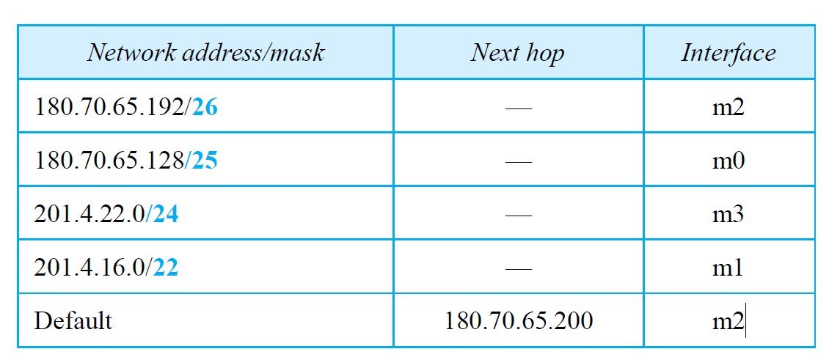
Forwarding packets
examples
Network Configuration
Forwarding table for Router R1
Show the forwarding process if a packet arrives at R1 with the destination address 180.70.65.140.
Calculate Network Address of IP 180.70.65.140 with CIDR /26 will result 180.70.65.128 /26 → there is no NA specify in Routing table R1
Calculate Network Address of IP 180.70.65.140 with CIDR /25 will result 180.70.65.128 /25 → match with corresponding network address in Routing Table R1 (connected to interface m0)
Notes:
When a packet arrives whose leftmost 26 bits in the destination address match the bits in the first row, the packet is sent out from interface m2.
When a packet arrives whose leftmost 25 bits in the address match the bits in the second row, the packet is sent out from interface m0. And so on.
Table 7.4 clearly shows that the first row has the longest prefix and the fourth row has the shortest prefix.
The longer prefix means a smaller range of addresses;
the shorter prefix means a larger range of addresses.

Slide 6
Forwarding packets
Longest mask matching
All 4 organizations in one area (connected to router in closed area)
Organization 4 closed to Router R2 – connected to Router R2
Notes:
Please see Forouzan – text book, Page 251 – 252 (Address Aggregation)

Slide 7
Routing packets
Routing a packet from its source to its destination means routing the packet from a source router (the default router of the source host) to a destination router (the router connected to the destination network).
Although a packet needs to visit the source and the destination routers, the question is what other routers the packet should visit.
In other words, there are several routes that a packet can travel from the source to the destination; what must be determined is which route the packet should take.

Slide 8

Routing packets
Least-cost routing
F
Notes:
Please see book Forouzan Chapter 8, page 287 – 288
Setiap router memiliki routing tabel sendiri-sendiri
Dalam hal pengiriman packet dari satu router ke router lainnya, umumnya menggunakan Least-Cost algorithm.
Dimana dari setiap router ada perhitungan least-cost ke semua router lainnya yang terdapat dalam 1 group.
Contoh Analisa untuk tree warna kuning.
Router A sebagai Root of the tree dengan Analisa sbb :
Cost dari RA to RB adalah 2
Cost dari RA to RC adalah 2+5=7
Cost dari RA ke RD adalah 3
Cost dari RA ke RE adalah RA-RB-RE = 2+4=6
Cost dari RA ke RE via RD adalah RA-RD-RE = 3+5 = 8 ← tidak digunakan algorithm ini karena tidak paling pendek atau murah.
Cost dari RA ke RF via RB-RE-RF = 2+4+2 = 8
Cost dari RA ke RG via RB-RE-RF-RG = 2+4+2+1 = 9

Slide 9
Routing packets
The distance vector corresponding to a tree
Router design
Router design for node A
Notes:
Please see book Forouzan Chapter 8, page 287 – 291
Setiap router memiliki routing tabel sendiri-sendiri
Dalam hal pengiriman packet dari satu router ke router lainnya, umumnya menggunakan Least-Cost algorithm.
Dimana dari setiap router ada perhitungan least-cost ke semua router lainnya yang terdapat dalam 1 group.
Contoh Analisa untuk tree warna kuning.
Router A sebagai Root of the tree dengan Analisa sbb :
Cost dari RA to RB adalah 2
Cost dari RA to RC adalah 2+5=7
Cost dari RA ke RD adalah 3
Cost dari RA ke RE adalah RA-RB-RE = 2+4=6
Cost dari RA ke RE via RD adalah RA-RD-RE = 3+5 = 8 ← tidak digunakan algorithm ini karena tidak paling pendek atau murah.
Cost dari RA ke RF via RB-RE-RF = 2+4+2 = 8
Cost dari RA ke RG via RB-RE-RF-RG = 2+4+2+1 = 9

Slide 10
routing protocols
Routing Information
  About topology and delays in the internet
Routing Algorithm
  Used to make routing decisions based on information
Routing algorithms are implemented using routing protocols
Three types of routing algorithms
Distance-Vector Routing
Link-State Routing
Path-Vector routing

Slide 11
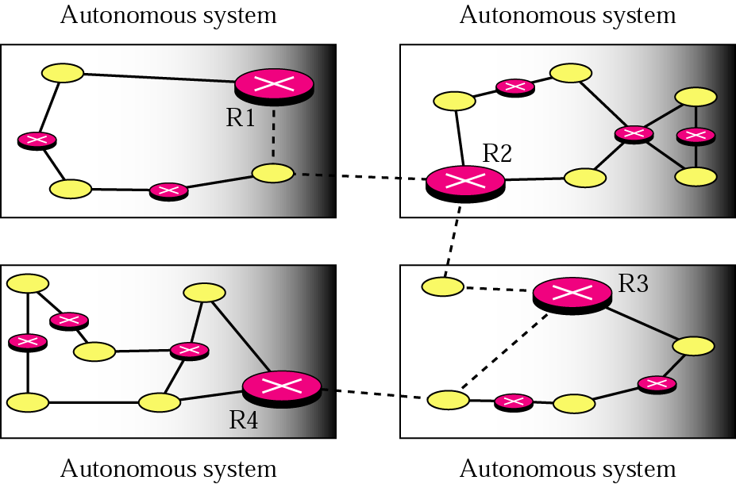
Routing
Autonomous systems (AS)
Group of routers
  Exchange information
  Common routing protocol
Set of routers and networks managed by single organization
A connected network
  There is at least one route between any pair of nodes

Slide 12
Routing protocol
Interior routing protocol (IRP)
Routing protocols that operate within a network (called an autonomous system) are called interior routing protocols.
Passes routing information between routers within AS
Routing algorithms and tables may differ between different AS
IRP needs detailed model

Slide 13
Routing protocol
Exterior Routing protocol (ERP)
Exterior router protocol (ERP) is used for operating outside of or between networks
Because there are many more possible routes it is far more complex than interior routing
It cannot maintain tables of every single route and have to concentrate instead on the main routes only.
There may be more than one AS in internet
Routing algorithms and tables may differ between different AS
Routers need some info about networks outside their AS
ERP supports summary information on reachability

Slide 14
Routing protocol
RIP (Routing information protocol)
Routing protocol commonly used on the Internet.
Computers using RIP broadcast routing tables every minute or so.
Now used on simpler networks
The original dynamic distance vector protocol

Slide 15
Routing protocol
Ospf (Open Shortest Path first)
Has overtaken RIP as the most popular interior routing protocol on the Internet
Has the ability to incorporate traffic and error rate measures in its routing decisions.
Sends updates state info, not entire routing tables, and only to other routers (not broadcasting them)
Each router keeps list of state of local links to network
Little traffic (less burdensome to the network since) as messages are small and not sent often
Route computed on least cost based on user cost metric using Link State Routing Algorithm

Slide 16
ROUTING TABLE
Routing Tables - CompTIA Network+ N10-006 - 1.9 – YouTube

Slide 17
exercise
What is the difference between RIP and OSPF protocol that used on router ?

Slide 18
Books reference
Forouzan, B. A. (2021). Data Communications and Networking with TCP/IP Protocol Suite. 6th Ed. New York: McGraw-Hill. ISBN: 978-1-26-436335-3. Chapter 7 & 8

Slide 19
Thank you
December 2024

